Slide 1


Determining Centrality at PHENIX
Ali Hanks
Journal Club
November 21, 2005

Slide 2
Outline
Why is centrality important?
The ZDC detector
The BBC detector
Glauber Model
Negative Binomial Distrbution (NBD)
Putting it all together

Slide 3

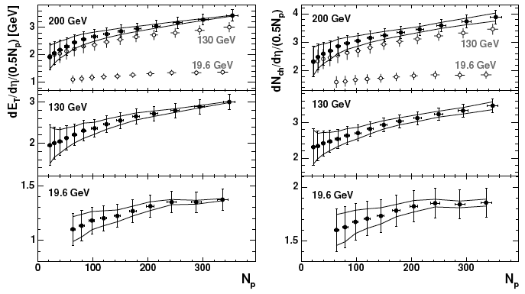
A few familiar examples
Many things we measure depend on centrality
  R_{AA} (Jaimin)
  E_{T} and N_{ch} => energy density
P.R. C71, 034908

Slide 4
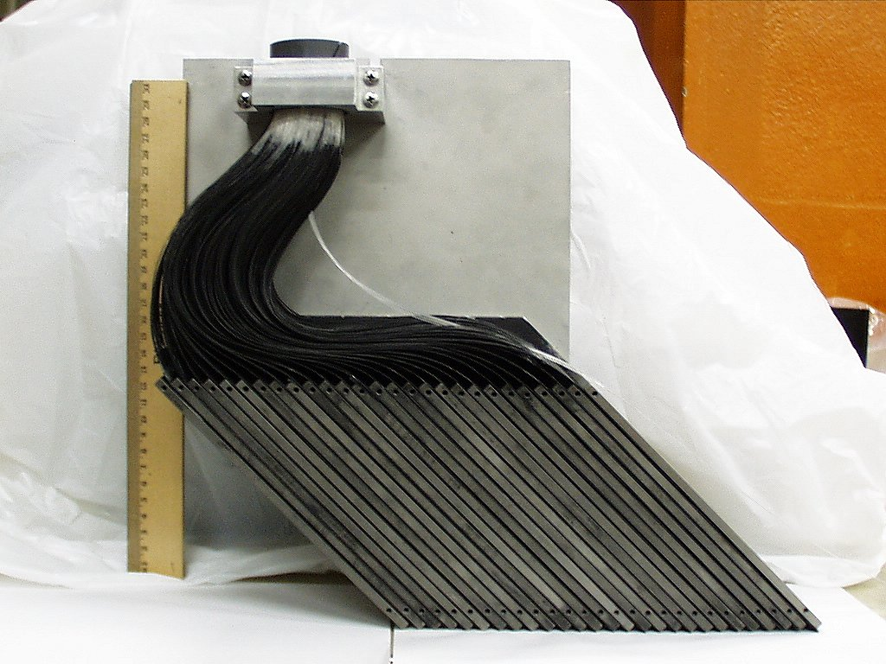
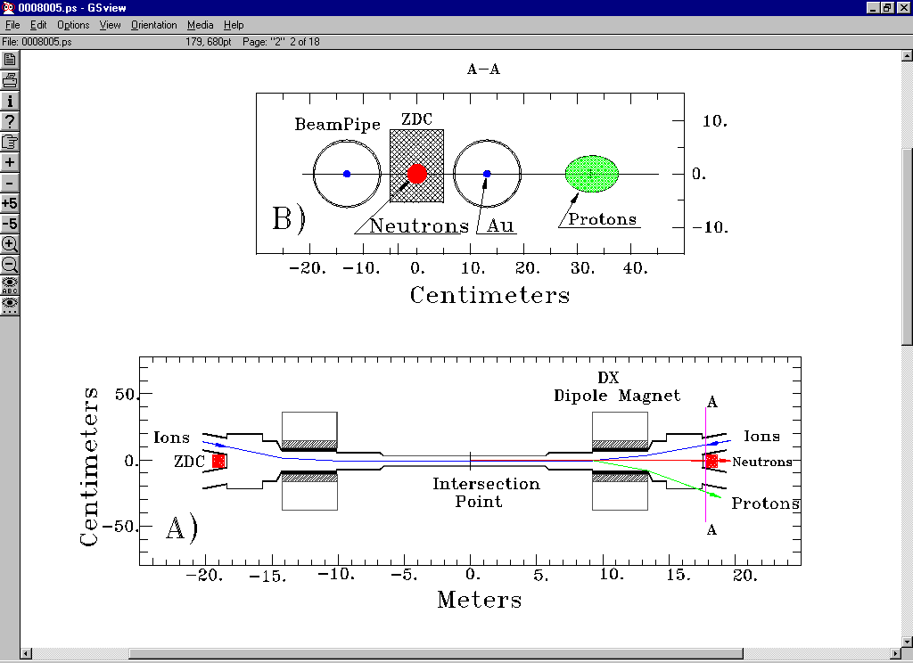
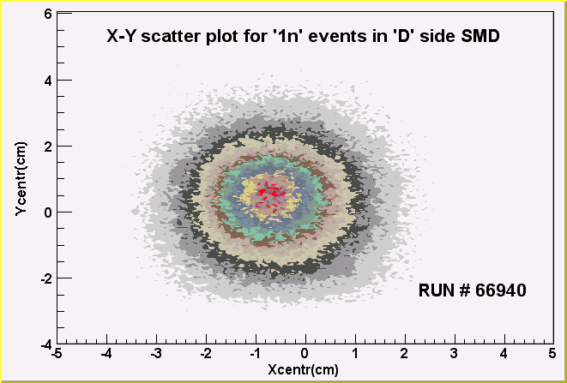
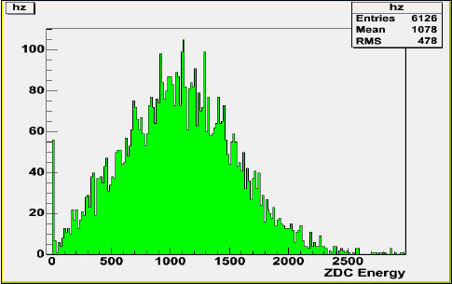
The ZDC detector

Slide 5
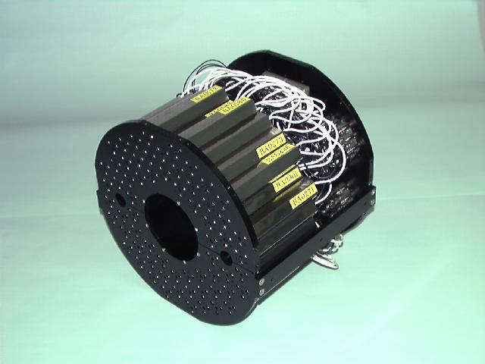
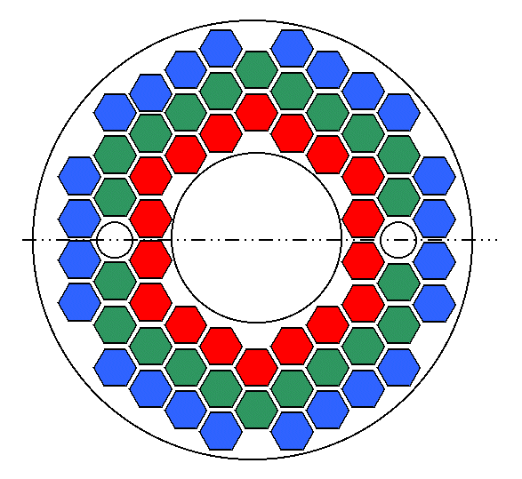
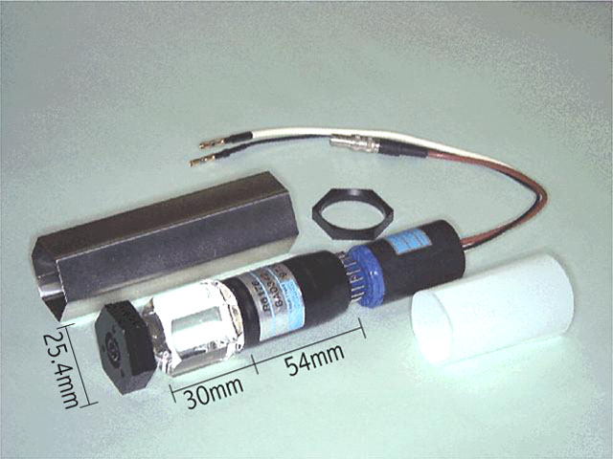
The BBC detector
R-direction
BBC
Collision point
beam pipe
Z-direction
RING ID
BBC
inner ring
middle ring
outer ring

Slide 6
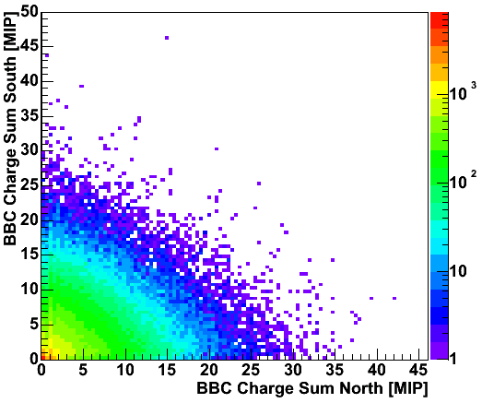
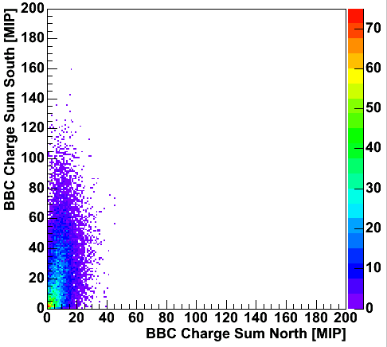
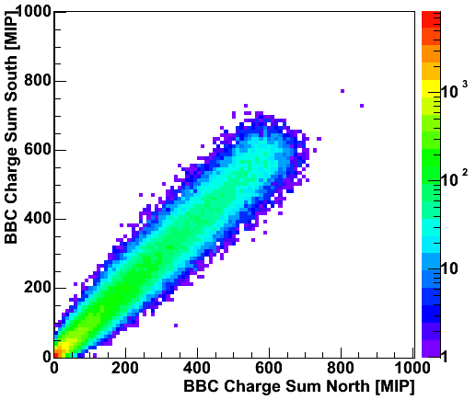
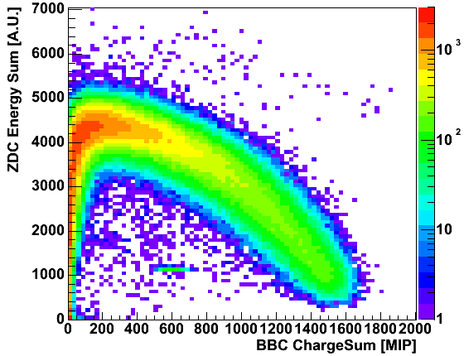
BBC Charge Sum
p+p (Run3)
d+Au (Run3)
Au+Au (Run4)
BBC charge sum is related to number of participant
It has also anti-correlation with ZDC energy sum.
participants
go into BBC
spectator
go into ZDC

Slide 7
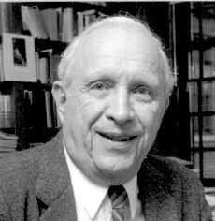
The Glauber Model
Nucleons are distributed according to a density function (e.g. Woods-Saxon)
Nucleons travel in straight lines and are not deflected as they pass through the other nucleus
Nucleons interact according to the inelastic cross section σ_{NN} measured in pp collisions, even after interacting
  Participants – counts nucleons which interact
  Binary collisions – counts collisions
nucl-th/0112039;
(Lectures in the theoretical physics,
ed. W. E. Brittin, L. G. Dunham,
Interscience, N. Y., 1959, v. 1, p. 315.)

Slide 8
The Woods-Saxon density function
Electron Scattering Measurements
H. DeVries, C.W. De Jager, C. DeVries, 1987

Slide 9
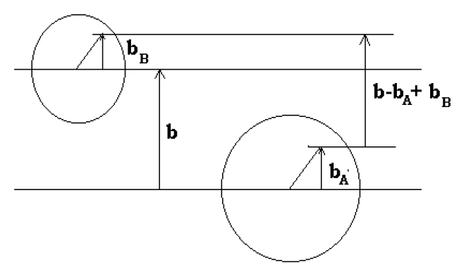

Some details
Probability of a nucleon-nucleon collision occuring at impact parameter b
Probability of finding a nucleon at a certain b and z in the nucleus
Probability for a nucleon-nucleon collision occurring when nuclei A and B are at a relative impact parameter b
Probability of n collisions occuring
where

Slide 10
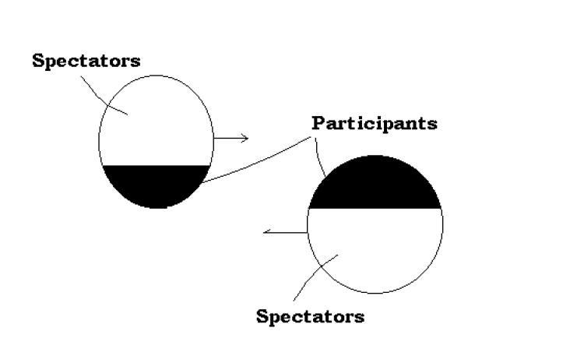




N_{part} & N_{coll} from Glauber
the probability no nucleons collide
=
So the probability of having α participants in nucleus A is:
So the total averages for a nucleus-nucleus collision at an impact parameter b are:
and the average is:

Slide 11
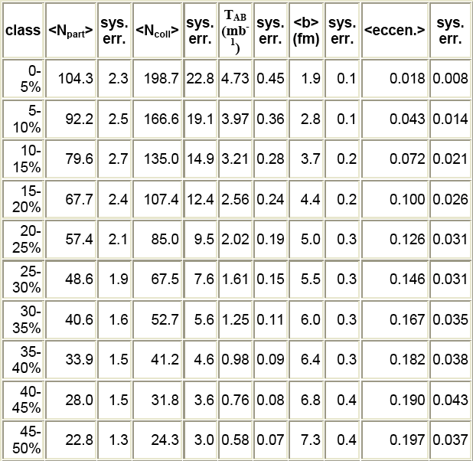
What do we do?
Monte-Carlo Glauber model (MCG)
  Generate events with range of impact perameters using Glauber
  Divide these events into centrality classes and get a table like this
How do we get back to real data?
  Remember the BBC count can be related to N_{part} … but how?

Slide 12
NBD
NBD distributions scaled with Glauber probabilities
Measured BBC count for fixed number of PC1 hits
The Negative Binomial Distribution (NBD) is given by:
  P(n,μ,k) = Γ(n+k)/(Γ(k)n!)·(μ/k)^{n}/(1+μ/k)^{n+k}
  where (σ/μ)² = 1/k + 1/μ give the width of the distribution
  Assuming N_{hits}~ N_{part} => μ ~ N_{part}
  Assuming all hits are uncorrelated => k ~ N_{part}

Slide 13
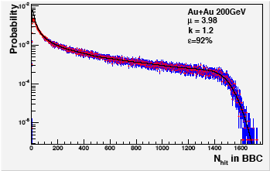
Fitting the BBC distribution
for N_{hit} ≥ 50 the trigger efficiency can assumed equal to 1
  P(N_{hit}) = ε(N_{hit})Σ_{Npart}NBD(N_{part},μ,k)xMCG(N_{part})
  Use fit to extract NBD parameters: μ and k
  Now we have a relationship between N_{part} and the actual N_{nit} in the BBC

Slide 14
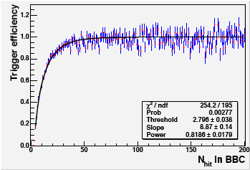
Trigger Efficiency
The last thing is to see how efficiently the BBC is tagging collisions
  Integrating this efficiency function gives the total trigger efficiency
    ~ 94% in Au-Au collisions

Slide 15
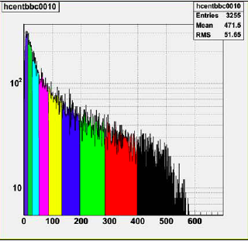
Centrality Bins
Each color corresponds to a centrality bin
  The bins are just percentage of total area under the curve
This gives N_{hit} in the given bin
  Use the NBD/MCG fit to relate this to <N_{part}> from the Glauber model
Can we do better?
  Recall that the efficiency get low for very periferal events (low N_{hit})
  The ZDC can help us

Slide 16
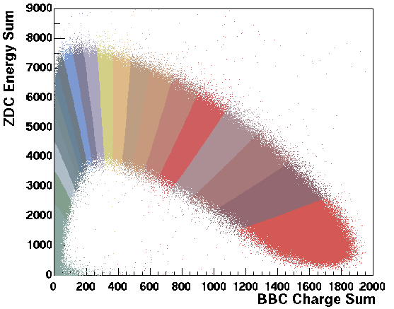
BBC vs ZDC
Centrality bins are again determined as a function of the total geometric cross section
Relating these bins to N_{part} is a little tricky now
  Use detector response simulations to match data and determine N_{part}
  Similar to NBD but complicated by ZDC
15-20%
10-15%
5-10%
0-5%
0-5%

Slide 17
Bibliography
S.S. Adler et al, PRC 71, 034908 (2005)
Analysis Note 210
Analysis Note 461
P. Shukla, nucl-th/0112039

